Slide 1
New Trends: Uncertainty and opportunity
Bronx Developmental Disabilities Council
Family Support Conference
Gary Lind, Executive Director AHRC NYC
May 22, 2014
Notes:
Welcome. Acknowledge Bill and Dorothy Stone. Kick off of new Family Ed Season.

Slide 2
Notes:
Are you a member? Overview of agency. Serve 14,000 NYers. Employ approx 4000. Relationships w national and state.

Slide 3
We are all a bit dazed and confused
Transformation
Reform
Innovation
Collaboration
Rate rationalization
The Front Door
Triple Aim
Coordinated Assessment System
DISCOs
MLTCs
Notes:
So many new ideas and terminology is coming at us. I hope we can have an open discussion about some of this and I hope when you leave you will have a better understanding of what is going on. I will try my best to explain but understand that that is not always an endorsement.

Slide 4
Seeds of Change: Federal Financing
Change
Consequence
End to reimbursement methodologies in DCs and other State operations.
Significant reductions in federal Medicaid in support of NYS budget
NY Medicaid under increased scrutiny
Loss of “favored” status
Trend factor era is over
Basis of public policy partnership in question
Rate rationalization
Transformation agreement
Access to new federal $
MFP
BIP

Slide 5
Seeds of Change: 26 Articles
At State-Run Homes, Abuse and Impunity
By DANNY HAKIM
Aiding Disabled, Nonprofits Rake in State Money
By RUSS BUETTNER
State Faults Care for the Disabled
By DANNY HAKIM
Cuomo Vows Reforms at Residential Care Agencies
By DANNY HAKIM
U.S. Report Criticizes New York on Monitoring Care of Developmentally Disabled
By DANNY HAKIM
Medicaid Overpaid New York on Disabled Care, U.S. Says
By DANNY HAKIM
Caregiver for Disabled People Sues New York State
By DANNY HAKIM
New York State Lags on Firing Workers Who Abuse Disabled Patients
By DANNY HAKIM

Slide 6
Consequence
Justice Center Implementation
Covers multiple State Agencies and populations
OPWDD
OMH
OCFS
SED
OASAS
Completely revamped incident reporting and investigation
Employment screening
A law enforcement agency
Code of conduct

Slide 7
Seeds of Change: ADA & Olmstead
Change
Consequence
Federal Department of Justice
Olmstead enforcement
Oregon & Rhode Island Settlements
NYS Olmstead Plan
Sheltered workshop transformation
Increase supported employment
Transition ICF/MR residents to community settings
Increase self-direction
Front Door

Slide 8
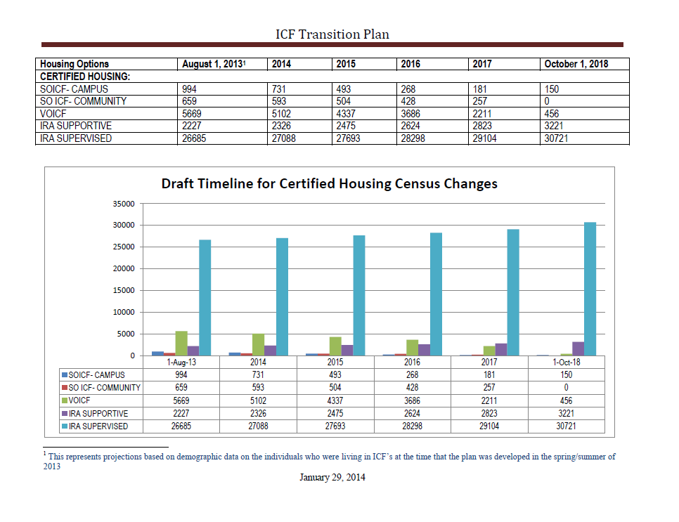

Slide 9
Key components include:
DDRO not provider agency function
Initial contact for those who are new or seeking to modify existing services
Determining eligibility for services
Assessment of strengths: DDP then CAS
Identifying support needs
Emphasis on self-direction, employment first, non-traditional
Plan authorization and implementation
Notes:
Implicit is that agencies drive people to services they do not want or do not need. Go thru this and then go back to the previous slide.

Slide 10
Seeds of Change: Health Care Reform
Change
Consequence
NYS Medicaid Budget
End of fee-for-service health care
Federal Affordable Care Act
Medicaid Reform Task Force
Triple Aim
End to i/dd carve out
People First Waiver

Slide 11
Seeds of Change: HCBS Waiver
Change
Consequence
OPWDD’s Waiver renewal scheduled for October
Federal CMS issues new HCBS regulations
Community based setting defined
Contentious negotiations
Transition period
Transformation agreement fulfilled
Person centered planning
Employment
Non-traditional housing
Conflict-free case mgmt
Self-direction

Slide 12
HCBS Rule – Provider Controlled Housing
Individual must have lease or legally enforceable agreement
Individual has privacy in their living unit including:
Lockable doors
Choice of roommates
Freedom to furnish/decorate
Individual controls own schedule
Individual has access to food at any time
Individual can have visitors at any time
Physical accessibility to the setting

Slide 13
Managed Care Overview
Current Medicaid Payments
Fee for Service
Future Managed Care Payments
Aggregate Total Costs divide by Total Number of People
Per Member Per Month PMPM
Acuity Factor
Risk Based System and an Insurance Model
Placing a “bet” that you can meet all needs within total dollars
Risk Reserves
Highly regulated by State DOH and DFS

Slide 14
Managed Care Status
Still anticipating an RFA for DISCO pilots
Approval of 1915 b/c waiver held up with CMS
Contingent on rate rationalization
Actuarially sound rates
Last year’s state budget included language for “DD” benefit to add to existing state Medicaid managed care contracts

Slide 15
Five Metro Area NYSARC Chapters
AHRC NYC
AHRC Nassau
AHRC Suffolk
Rockland Arc
Westchester Arc
The only FIDA Demonstration for people with intellectual and developmental disabilities
Built from the ground up not layered onto something that already exists
NYS Article 44 license, Federal CMS Medicare approvals

Slide 16
NYS Budget
Good news was:
2% increase for DSPs (in January 2015)
A promised 2% increase in April 2015 for DSPs and Clinical
Bad news was:
No increase for Pre-Schools
May be an increase for 853 Schools
Development of new opportunities bears watching
Let’s be sure that our issues remain front and center.

Slide 17
Wrap up
Only certainty is change
Our values and aspirations are constant
Speak up
Advocacy was never more important
OPWDD welcomes comments
Building a voice with DOH
Value of the partnership
Strength of a families and self advocates
Stay informed – Bronx DD Council, web sites, social media

